Slide 1
THE CHEMIST’S NOTEBOOK
Sahil Raichurkar Ex354 [F2306-1160]
Nachiket Mahajan Ex358 [F2306-1157]
Piyush Raundal Ex367 [F2306-1153]

Slide 2
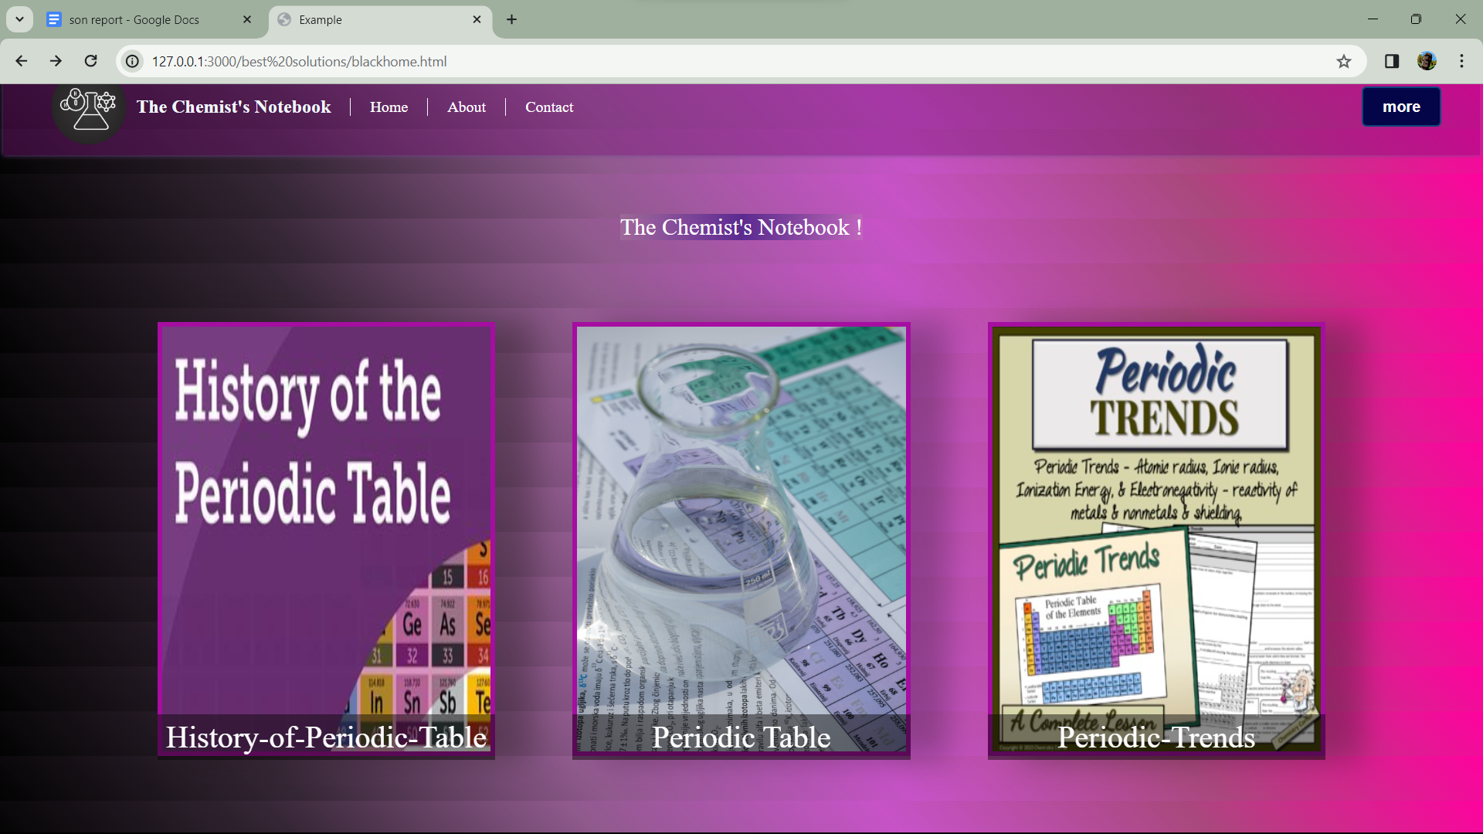
Exploring History, Structure, and Trends of the Periodic Table

Slide 3
PERIODIC TABLE

Slide 4
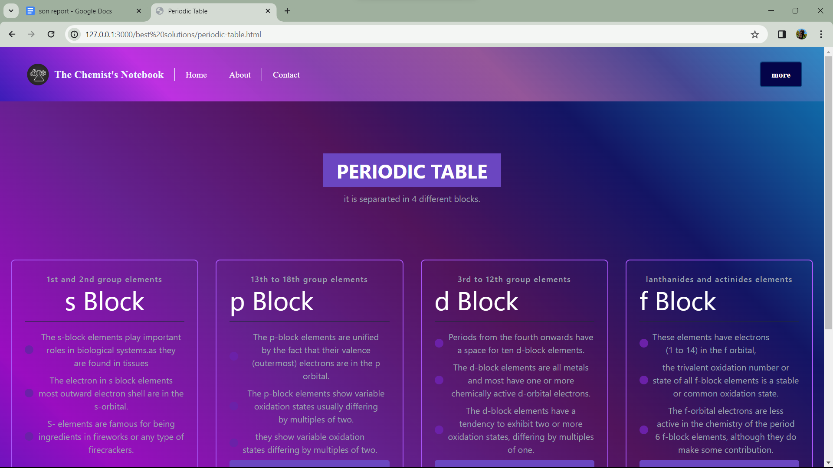
The periodic table is a chart of elements that helps scientists understand and predict how different materials behave. It organizes elements based on their properties, making it a handy tool for studying and discovering new things in the world of chemistry.

Slide 5
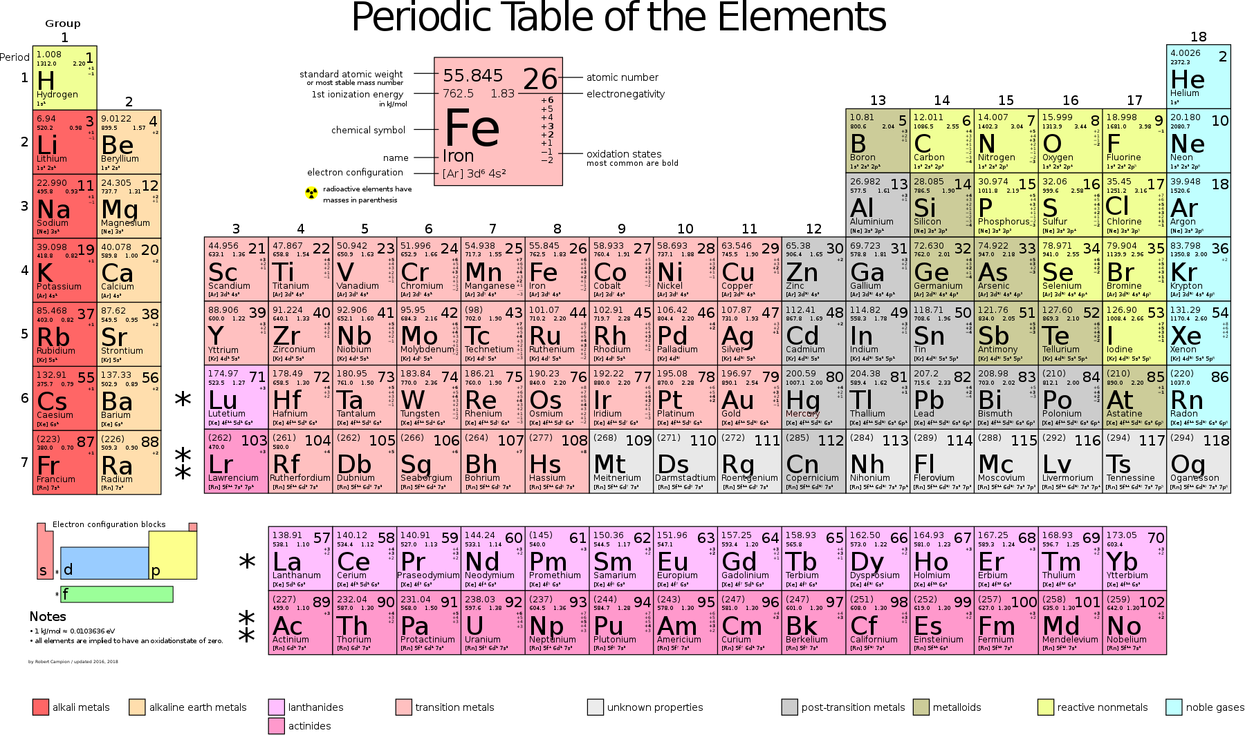

Slide 6
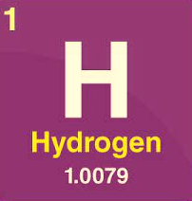
Symbol of the Element
Atomic Number of the Elemt
Name of the Element
Mass Number of the Element

Slide 7
History of Periodic table

Slide 8
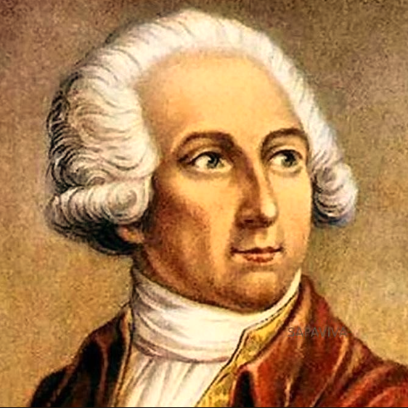
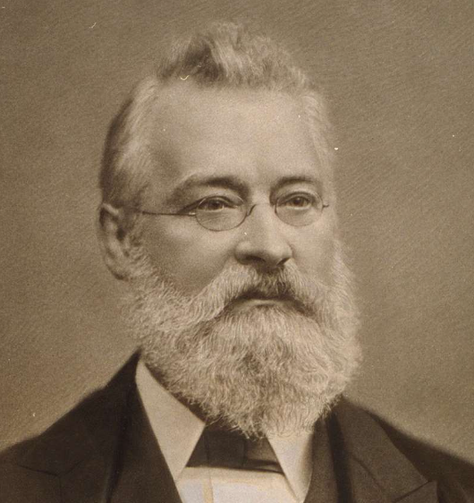
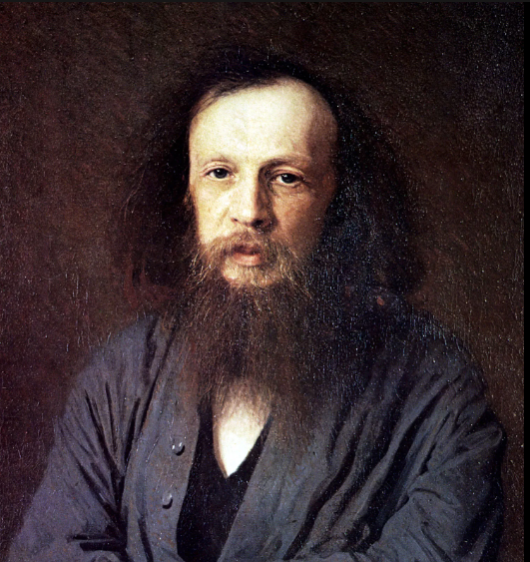
Antoine Lavoisier (1789)
John Newlands (1864)
Dmitrii Mendeleev (1869)
Lavoisier, often referred to as the "Father of Modern Chemistry“, laid the foundation for the periodic table by establishing the law of conservation of mass and identifying and naming several chemical elements.
Newlands proposed the Law of Octaves, which suggested that every eighth element had similar properties. While his idea had some merit, it was limited and not widely accepted.
Mendeleev, a Russian chemist, created the first periodic table by arranging 63 known elements based on their atomic masses. He cleverly left gaps for undiscovered elements and predicted their properties. This groundbreaking table laid the foundation for our modern periodic table.

Slide 9
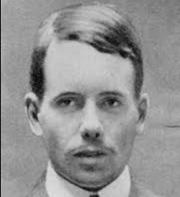

Henry Moseley (1913-1914)
Glenn T. Seaborg (1940s-1950s)
Moseley, an English physicist, upgraded the periodic table by using X-rays to determine atomic numbers instead of atomic masses. This improved accuracy and organization, addressing issues with Mendeleev's version..
Seaborg, an American chemist, helped discover elements beyond uranium and suggested an expanded periodic table. He rearranged the table by placing the actinide series below the lanthanide series, contributing to the modern periodic table layout.

Slide 10
Blocks in Periodic Table

Slide 11
Groups and Periods
GROUPS
PERIODS
Vertical columns on the periodic table.
Elements in the same group have similar chemical properties.
Groups are labeled with numbers and sometimes letters.
18 Groups
Horizontal rows on the periodic table.
Elements in the same period have the same number of electron shells.
The period number indicates the energy level of the outermost electrons
7 Periods

Slide 12
S Block
P Block
D Block
F Block
Located on the left side of the periodic table.
Includes groups 1 and 2 (alkali and alkaline earth metals).
The outermost electrons fill the s-subshell.
Located in the middle of the periodic table, between the s- and p-blocks.
Includes transition metals (groups 3 to 12).
The outermost electrons fill the d-subshell.
Located on the right side of the periodic table.
Includes groups 13 to 18.
The outermost electrons fill the p-subshell.
Located below the main body of the periodic table.
Includes the lanthanides (from cerium to lutetium) and actinides (from thorium to lawrencium).
The outermost electrons fill the f-subshell.

Slide 13
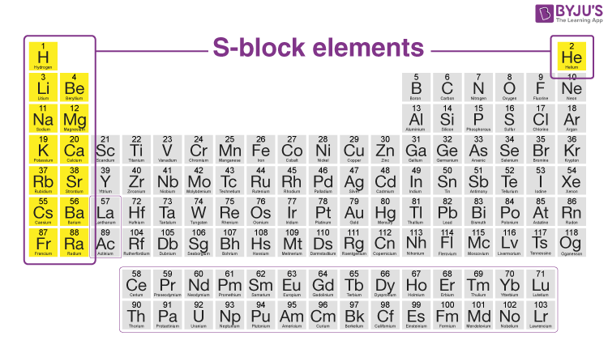
S Block

Slide 14
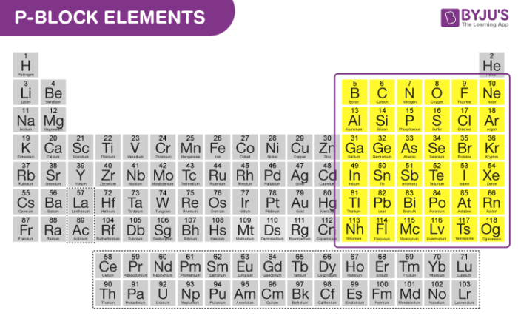
p Block

Slide 15
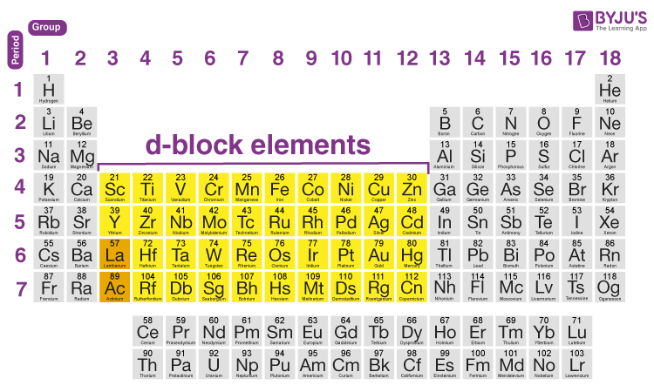
d Block

Slide 16
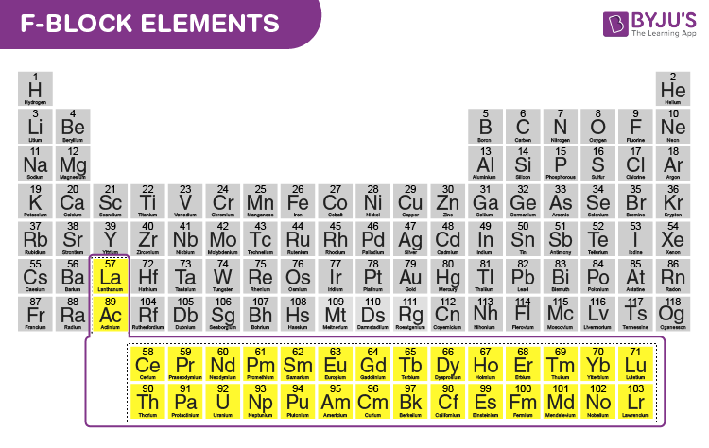
f Block

Slide 17
Atomic Trends

Slide 18
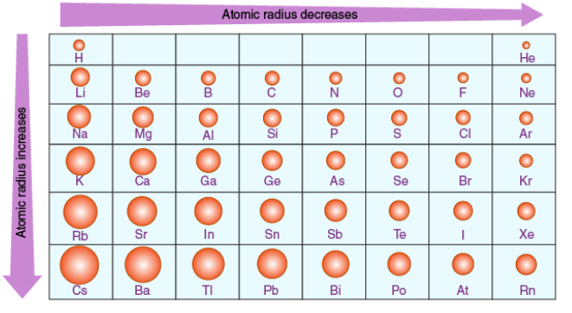
Atomic Radius
The atomic radius is a measure of the size of an atom, typically defined as the distance from the nucleus of an atom to the outermost electron orbit.
As you move from left to right across a period, the atomic radius generally decreases.
As you move down a group, the atomic radius generally increases

Slide 19
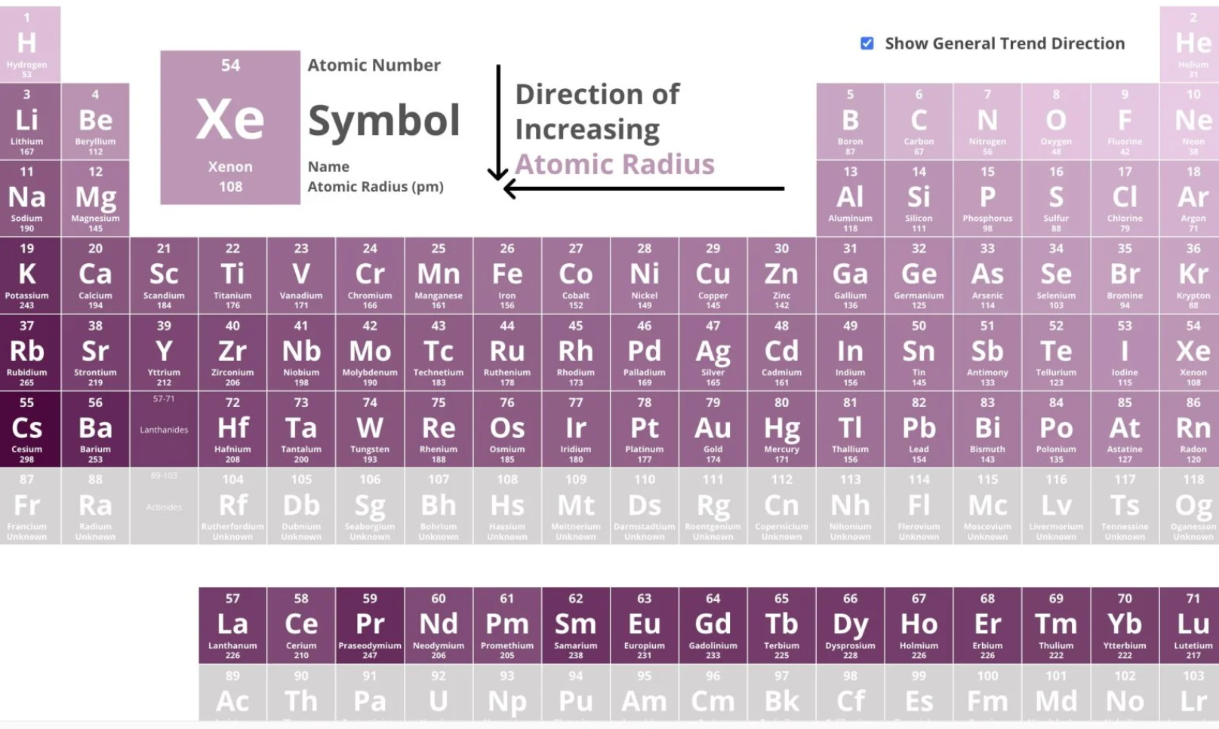
Ionic Radius
Ionic radius is the distance between nucleus of ion to outermost valence electron
As you move from left to right across a period, the ionic radius generally decreases.
As you move down a group, the ionic radius generally increases

Slide 20
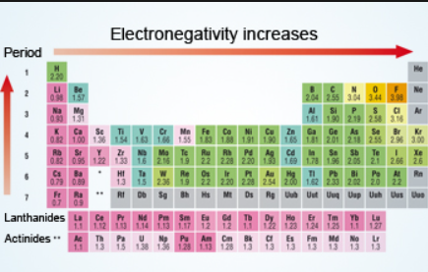
Electronegativity
Electronegativity is a measure of the tendency of an atom to attract a bonding pair of electrons when it is part of a compound.
Electronegativity generally increases across a period on the periodic table.
Electronegativity generally decreases down a group on the periodic table.

Slide 21
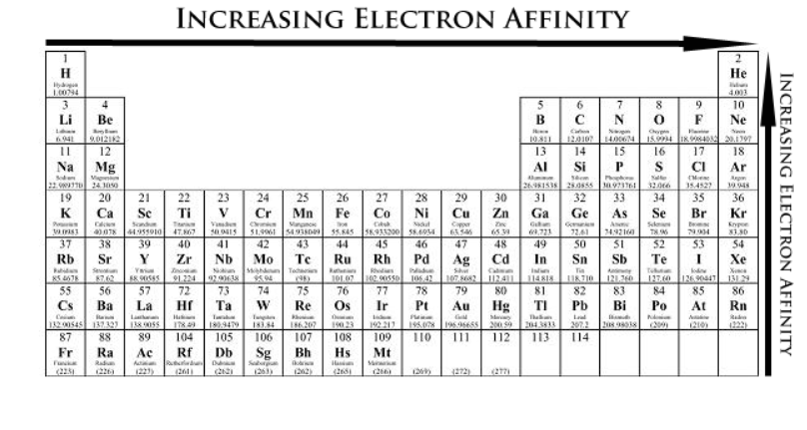
Electron affinity
Electron affinity is the amount of energy released or absorbed when an atom gains an electron to form a negative ion (anion).
Electron affinity tends to increase across a period on the periodic table.
Electron affinity tends to decrease down a group on the periodic table.

Slide 22

Ionization Energy
Ionization energy is the energy required to remove an electron from a neutral atom in its gaseous state, resulting in the formation of a positively charged ion (cation).
Ionization energy increases across a period on the periodic table.
Ionization energy tends to decrease down a group on the periodic table.

Slide 23
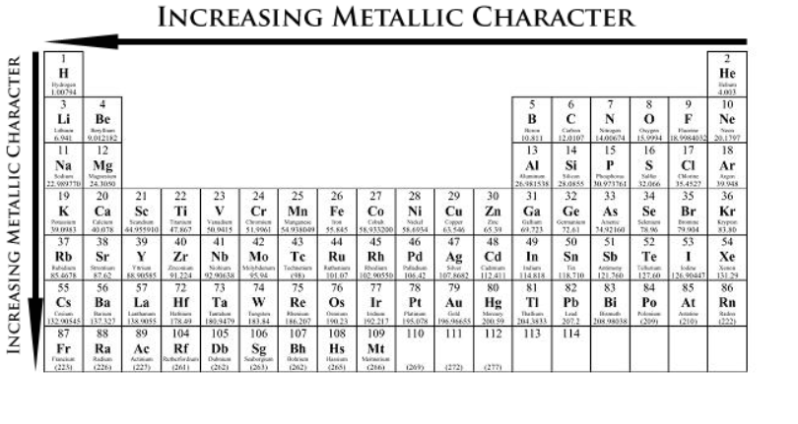
Metallic Character
Metallic character refers to the extent to which an element exhibits the physical and chemical properties characteristic of metals.
Metallic character tends to decrease across a period.
Metallic character tends to increase down a group.

Slide 24
THANKS
Contact us :
Nachiket Mahajan-- 202301060047@mitaoe.ac.in
Piyush Raundal-- 202301060043@mitaoe.ac.in
Sahil Raichurkar -- 202301060051@mitaoe.ac.in

